Slide 1
Main Application Page
Header Section:
Application Title
Application Version
Logged in username
Logout icon
AxeOS Device: Name
Current Hashrate
Expected Hashrate
Difficulty (Best & Session)
Pool Difficulty
Shares
ASIC Temp
VR Temp
Fan Speed %
Fan Speed RPMs
AxeOS Device: Name
Current Hashrate
Expected Hashrate
Difficulty (Best & Session)
Pool Difficulty
Shares
ASIC Temp
VR Temp
Fan Speed %
Fan Speed RPMs
AxeOS Device: Name
Current Hashrate
Expected Hashrate
Difficulty (Best & Session)
Pool Difficulty
Shares
ASIC Temp
VR Temp
Fan Speed %
Fan Speed RPMs
AxeOS Device: Name
Current Hashrate
Expected Hashrate
Difficulty (Best & Session)
Pool Difficulty
Shares
ASIC Temp
VR Temp
Fan Speed %
Fan Speed RPMs
For each mining pool configured
Mining Core Instance: Pool Name
Network Hashrate
Network Difficulty
Last Block Time
Block Height
Connected Peers
Node Version
Connected Miners
Pool Hashrate
Rewards: Total Paid
Rewards: Total Blocks
Rewards: Total Confirmed Blocks
Rewards: Total Pending Blocks
Rewards: Last Pool Block Time
Rewards: Block Reward
For each mining pool configured
Mining Core Instance: Pool Name
Network Hashrate
Network Difficulty
Last Block Time
Block Height
Connected Peers
Node Version
Connected Miners
Pool Hashrate
Rewards: Total Paid
Rewards: Total Blocks
Rewards: Total Confirmed Blocks
Rewards: Total Pending Blocks
Rewards: Last Pool Block Time
Rewards: Block Reward
Footer Section:
Copy right notice
Author: Scott Walter
Last updated timestamp
Application version

Slide 2
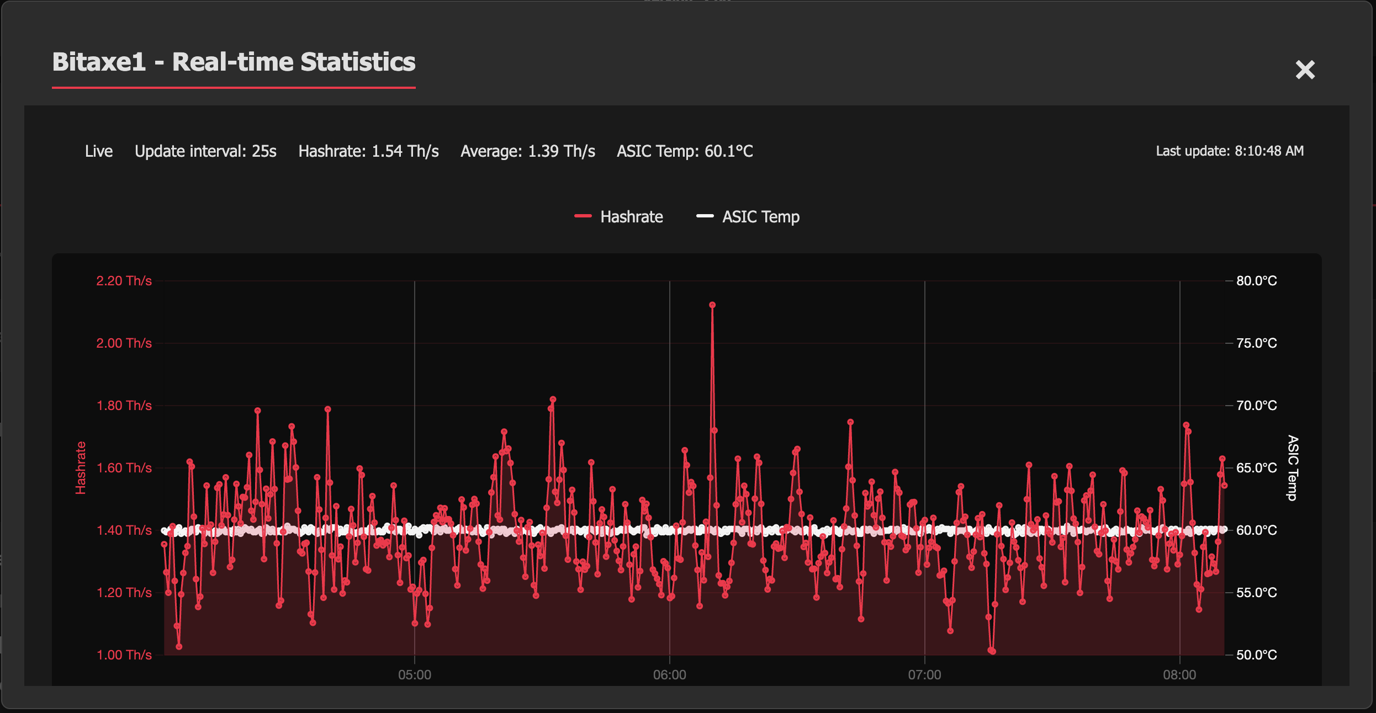
AxeOS Chart Modal

Slide 3
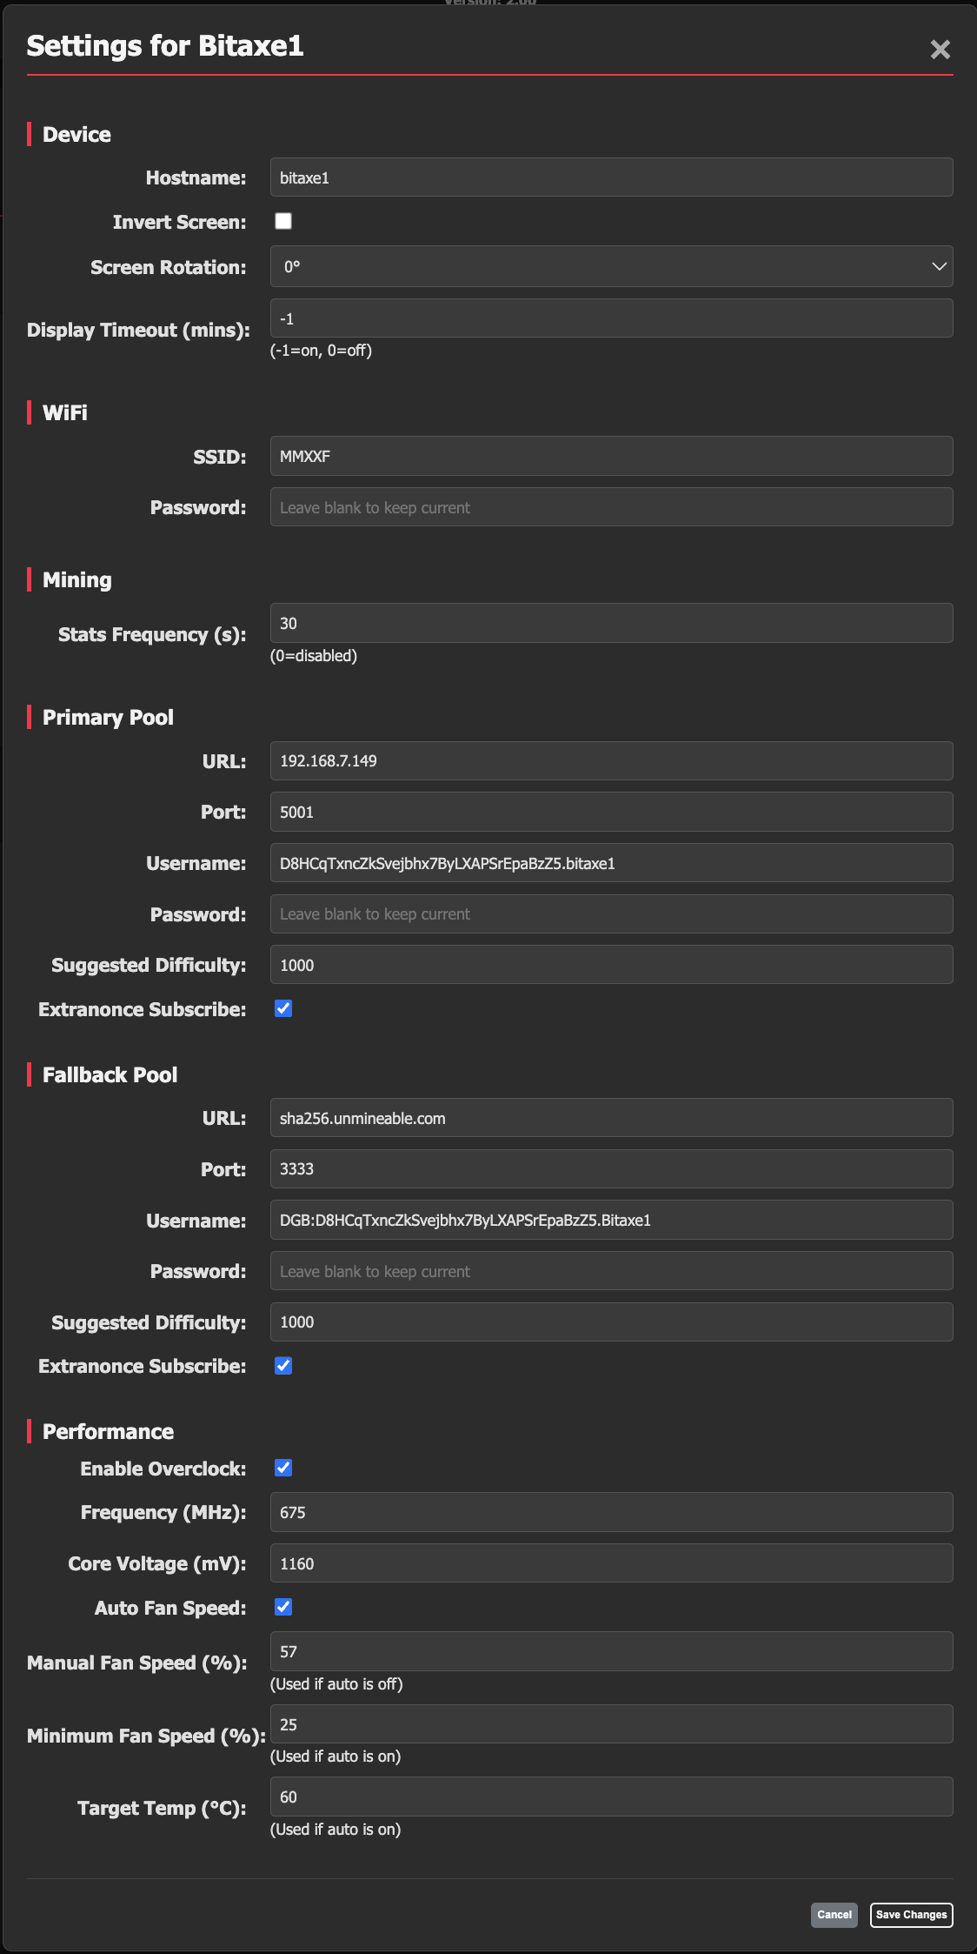
AxeOS Settings Modal

Slide 4
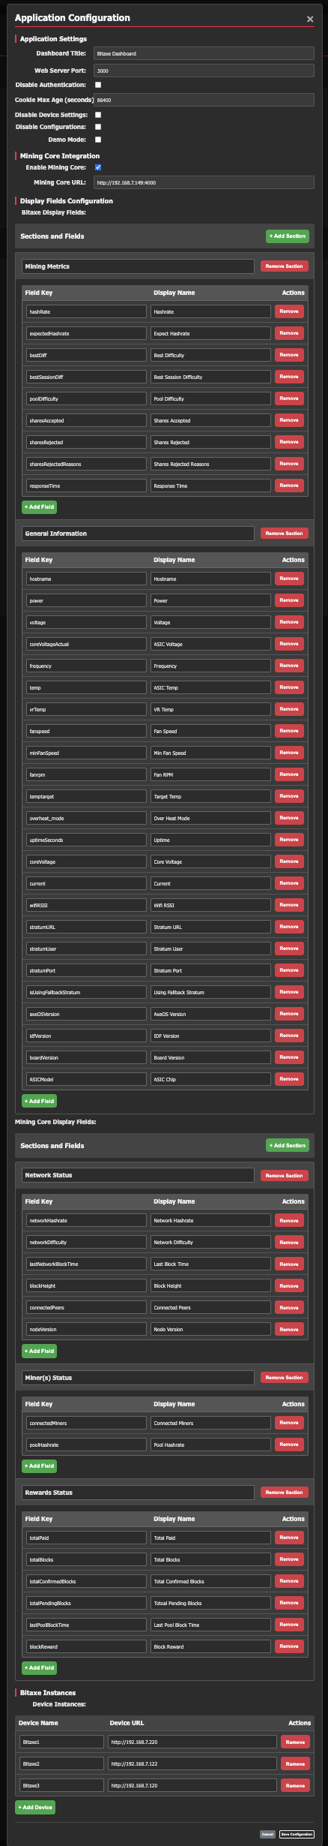
Application Configuration Modal

Slide 5
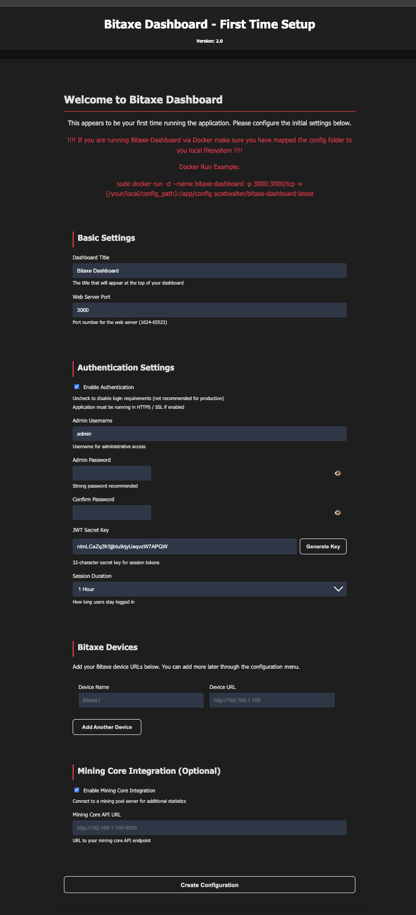
Bootstrap Page

Slide 6
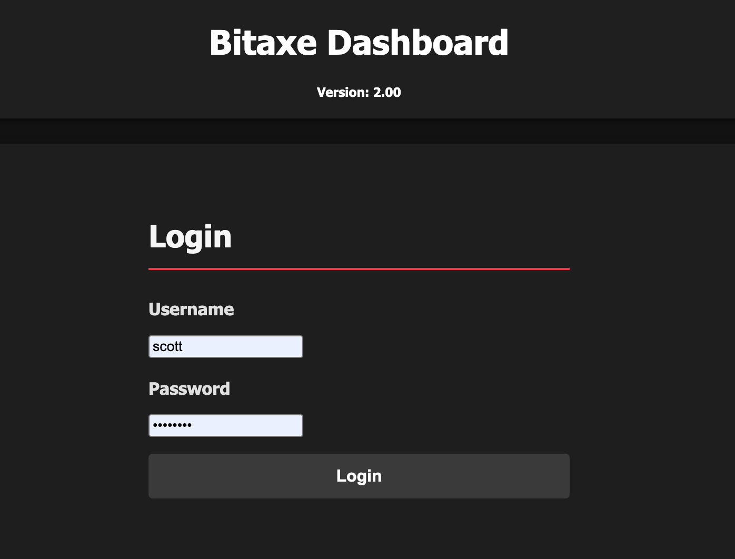
Login Page

